Slide 1

ORAL PRESENTATION
INCLUDES ALL THE MINI PROJECTS
TEAM NAME 3

Slide 2
MEMBERS OF THE TEAM
MEMBER 1 SAM LEADER
MEMBER 2 SAIRA
MEMBER 3 SHAYKH
MEMBER 4 HAMZA

Slide 3
MINI PROJECTS .
1 Mini Project 1: Northwest Architecture Studio Ltd. Team (20%)
2 Mini Project 2: Pennine Pizza Works Team (20%)
3 Mini Project 3: NorthWest Architecture Studio Network Team (20%)
4 Mini Project 4: Cyber-Security Awareness

Slide 4
MINI PROJECT ONE
PROBLEM :
Different staff needed different types of computers.
Basic office workers did not need expensive computers, but CAD and 3D design staff needed more powerful systems.
The team had to choose suitable hardware without going over budget.
SLOUTION :
We selected hardware based on each job's needs.
We compared component prices and explained why each item was suitable.
We used an SQL database to store workstation details and costs.
We considered value for money and avoided unnecessary spending.
WHAT WAS GIVEN :
12 workstations for four job roles.
Total budget: £27,450, including contingency.

Slide 5
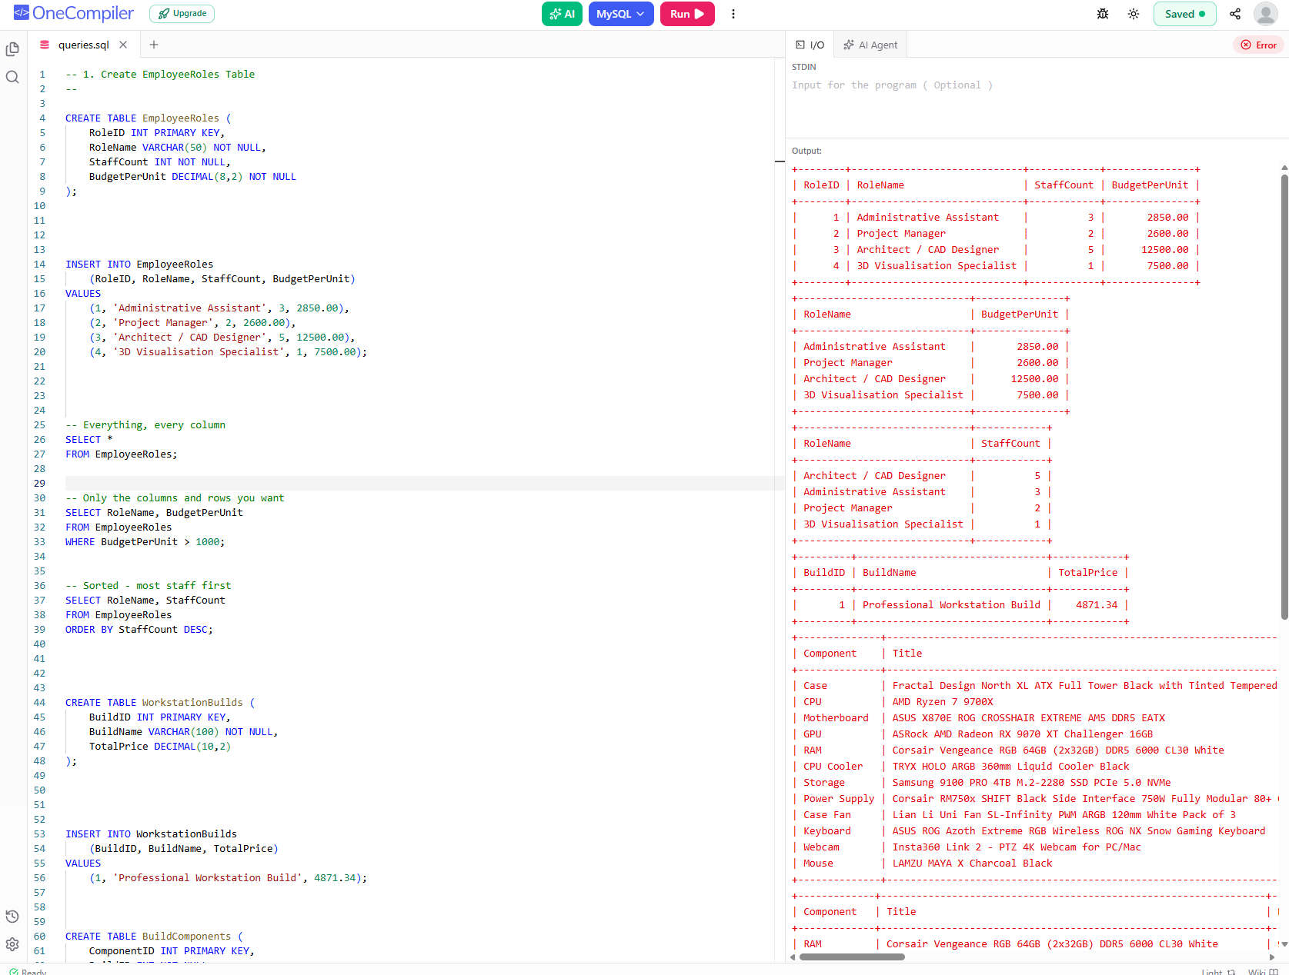
MINI PROJECT ONE
EVIDENCE

Slide 6
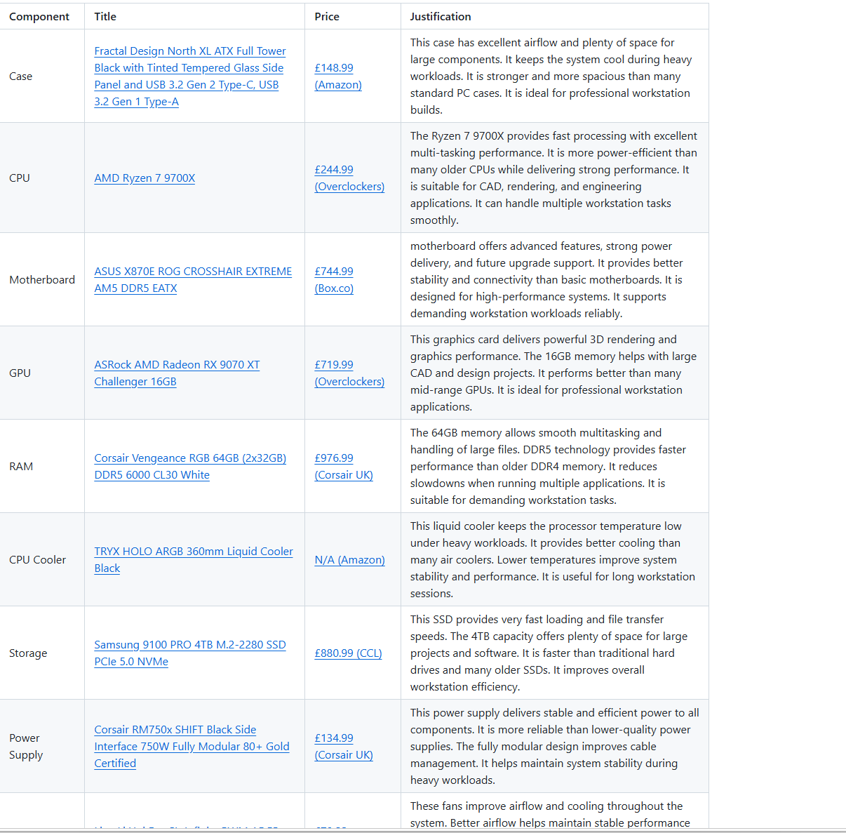
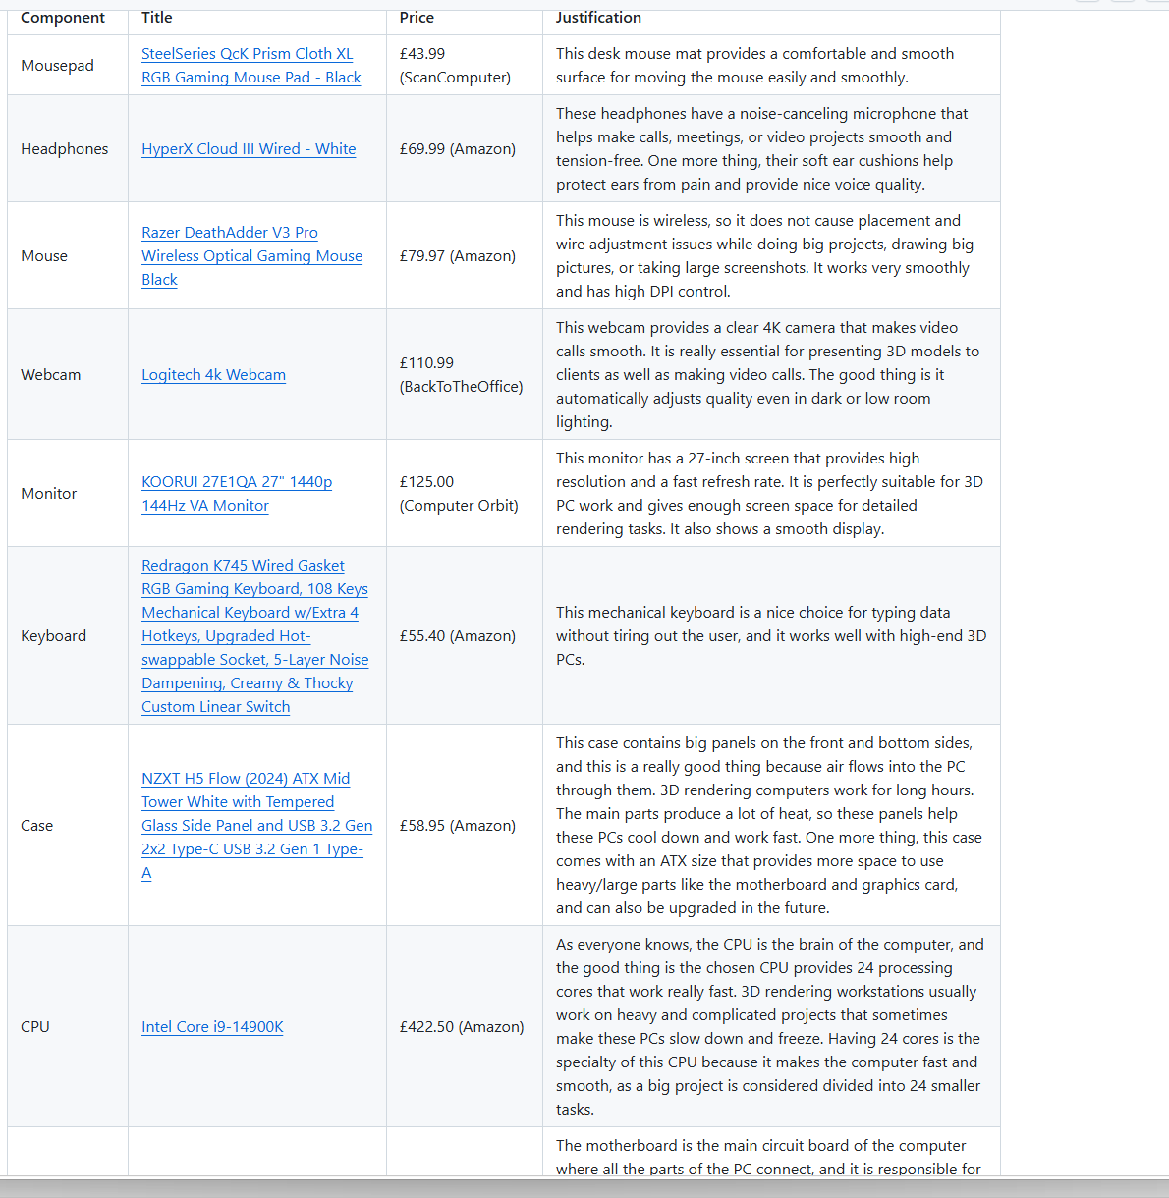
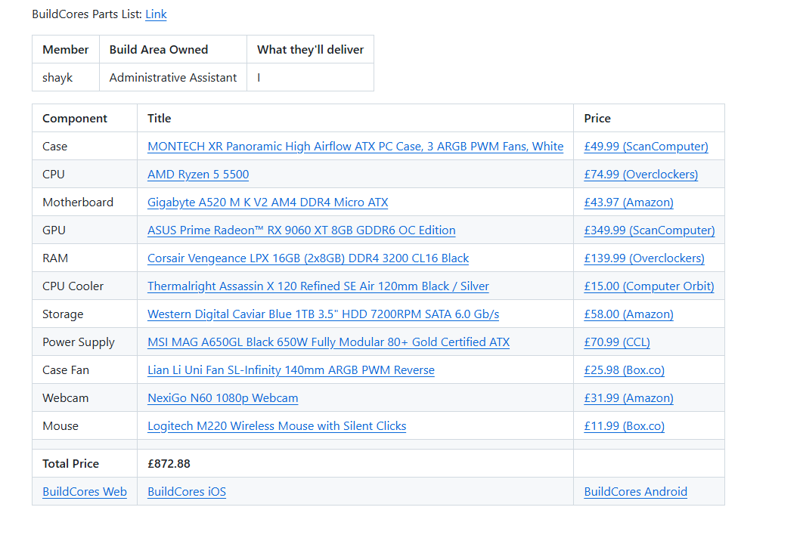

Slide 7
MINI PROJECT 2
PROBLEM :
Staff calculated prices manually.
Mistakes happened with totals, discounts, and delivery charges.
SLOUTION :
Staff calculated prices manually.
Mistakes happened with totals, discounts, and delivery charges.
WHAT WAS GIVEN :
A pizza shop needed an ordering system.
Staff had to enter customer details, pizzas, toppings, and delivery.
The program had to calculate bills, discounts, and charges.

Slide 8
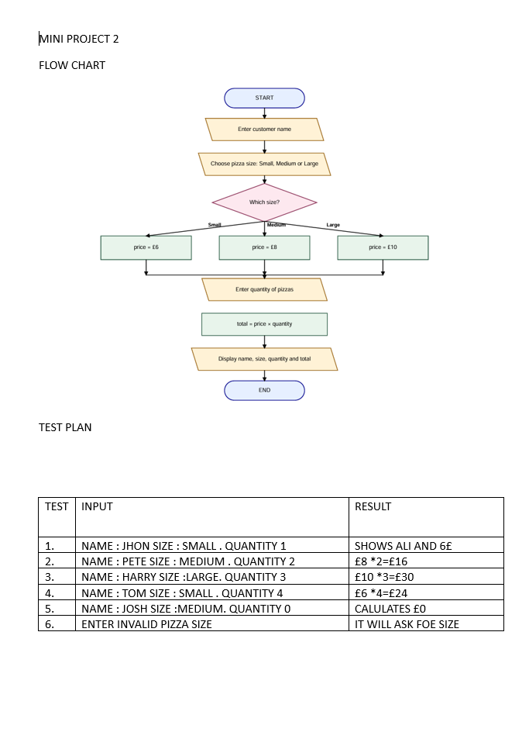

Slide 9
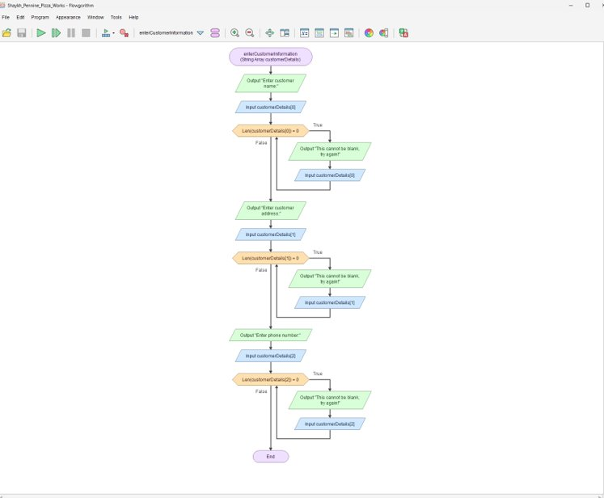
MINI PROJECT 2
EVIDENCE

Slide 10
MINI PROJECT 2
In testing we have check different test cases and these are:​
Normal Cases: Tested all the correct input(quantity, sizes, toppings and delivery).​
Boundary Cases: Checked the limits for making sure about the system work. ​
Abnormal Cases: Tested all the incorrect input like, (empty spaces, dots instead of correct information).​
Manually Checking : Tried to do all calculation using paper and calculator for verifying accurate results.​
​

Slide 11
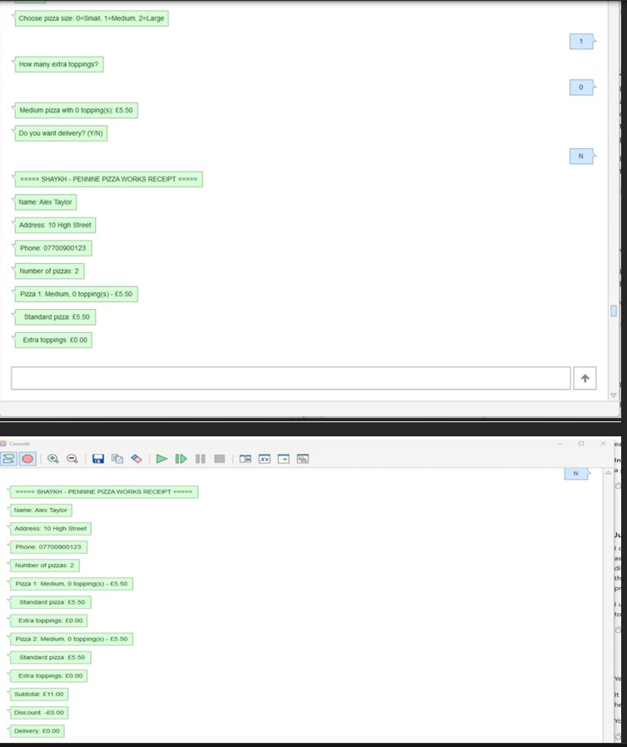
MINI PROJECT 2
EVIDENCE

Slide 12
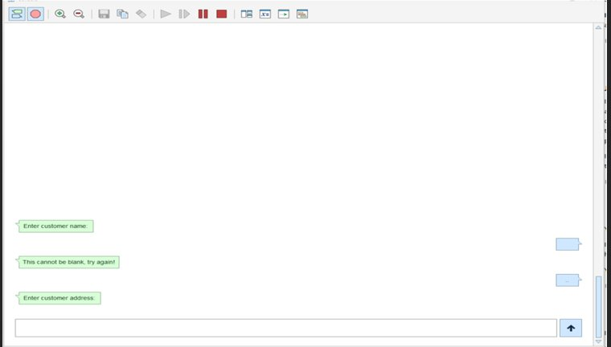
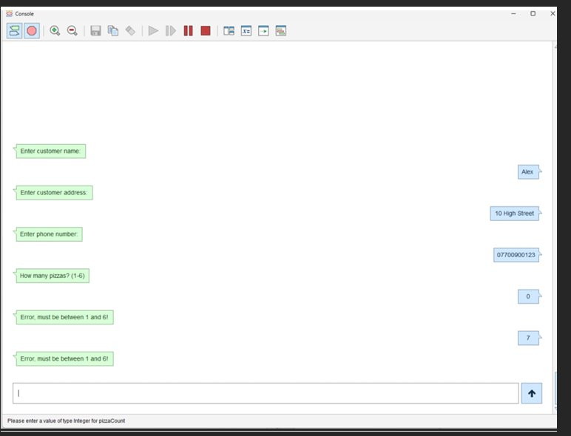
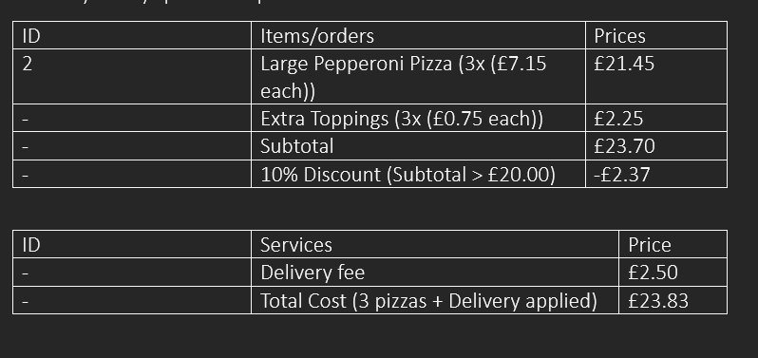

Slide 13
MINI PROJECT 3
PROBLEM :
Devices needed correct IP addresses.
Internal and external connections needed testing.
SOLUTION :
Connect devices using switches and a router.
Configure IP addresses and DNS.
Test websites and ping connections.
WHAT WAS GIVEN :
Build an office network in Filius.
Connect office PCs, servers, and cloud network.

Slide 14
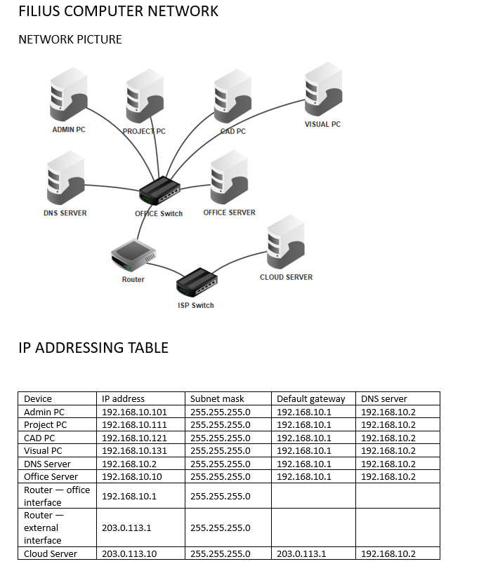
MINI PROJECT 3
EVIDENCE

Slide 15
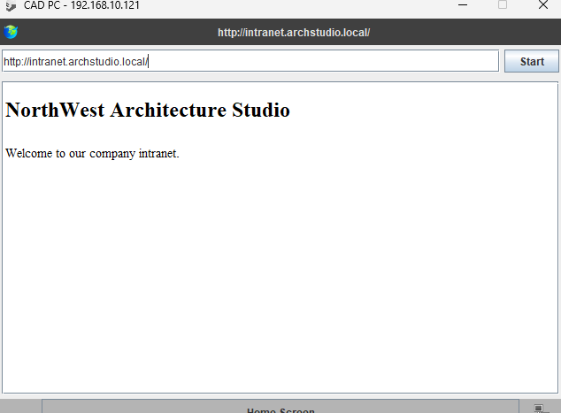
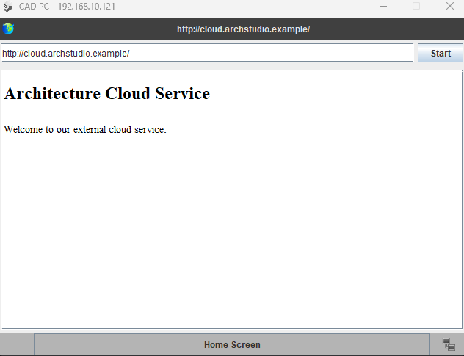
MINI PROJECT 3
EVIDENCE

Slide 16
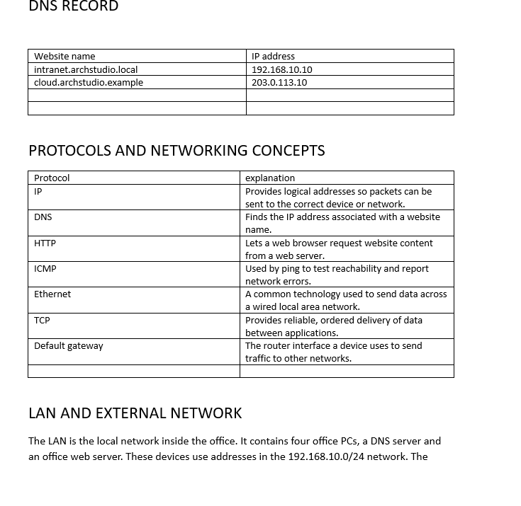

Slide 17
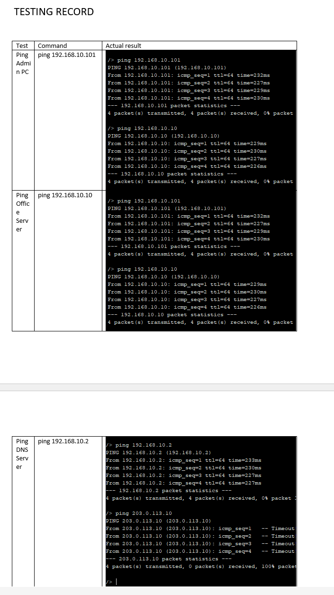
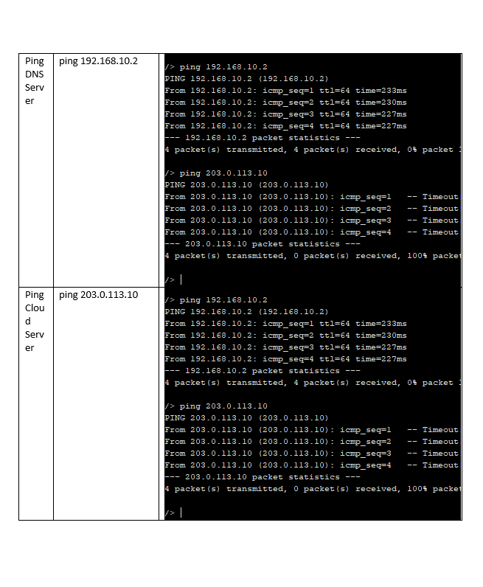

Slide 18
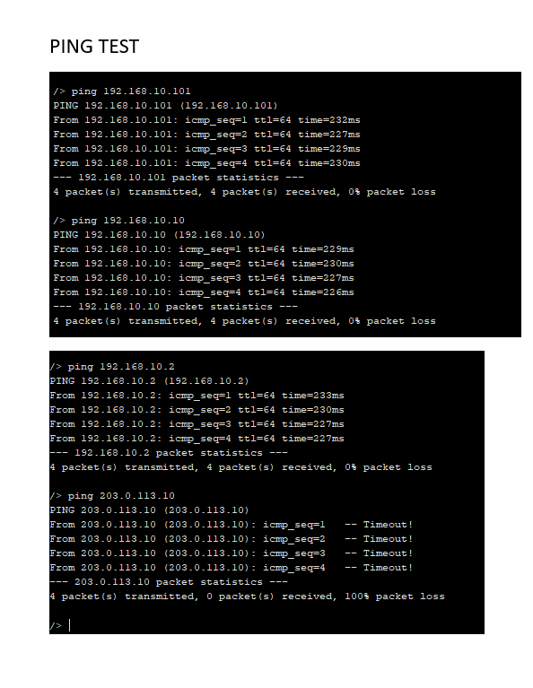

Slide 19
MINI PROJECT 4
PROBLEM :
People face online scams and security risks.
Weak passwords and unsafe habits can expose personal data.
SOLUTION :
Explain ways to stay safe online.
Research trusted sources.
Create a structured team report with references.
WHAT WAS GIVEN :
Write a report about online safety.
Cover passwords, 2FA, phishing, devices, and public Wi-Fi.
Use reliable sources and Harvard references.

Slide 20
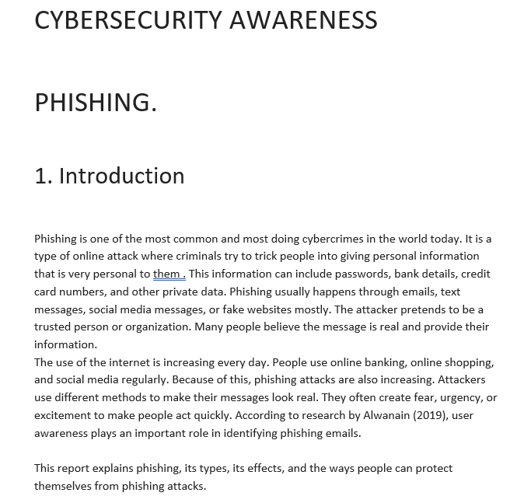
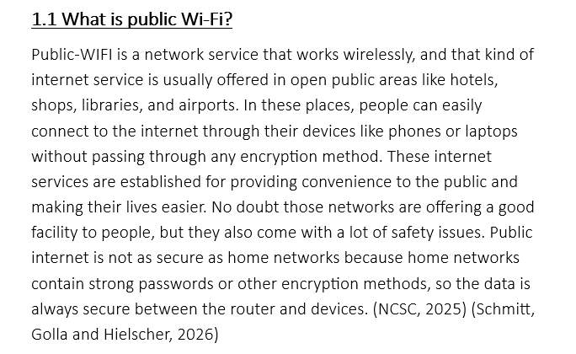
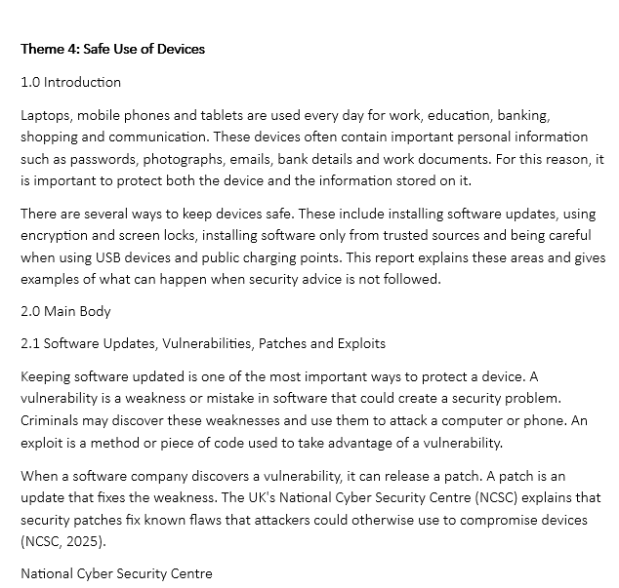
MINI PROJECT 4
EVIDENCE

Slide 21
LIVE DEMO ON GITHUB
MINI PROJECT FOUR
MINIPROJECT 2

Slide 22
https://github.com

Slide 23
REFLECTION
Learning Journey:
Learned new skills and software.
Faced difficulties but solved them through practice.
Improved my teamwork and problem-solving.
Gained more knowledge and confidence.

Slide 24

THANKYOU FOR YOUR ATTENTION
ANY QUESTION ?

